Slide 1
Electricity Bill calculation System
Index No : GADSE212F-023
Dinal Randika

Slide 2
Overview
The main objective of the Electricity Billing System is to manage the Details of Electricity, Bill, Connections, Store Record, and Customer and calculate the bill to Customer.
It manages all the information about Electricity bill of the customer.
The project is totally built at administrative thus only the administrator is guaranteed the access to the System.
The purpose of the project is to build an application program to reduce the manual work for allocated when generating and increase labor efficiency.
This Java application was created using Apache Net IDE 16

Slide 3
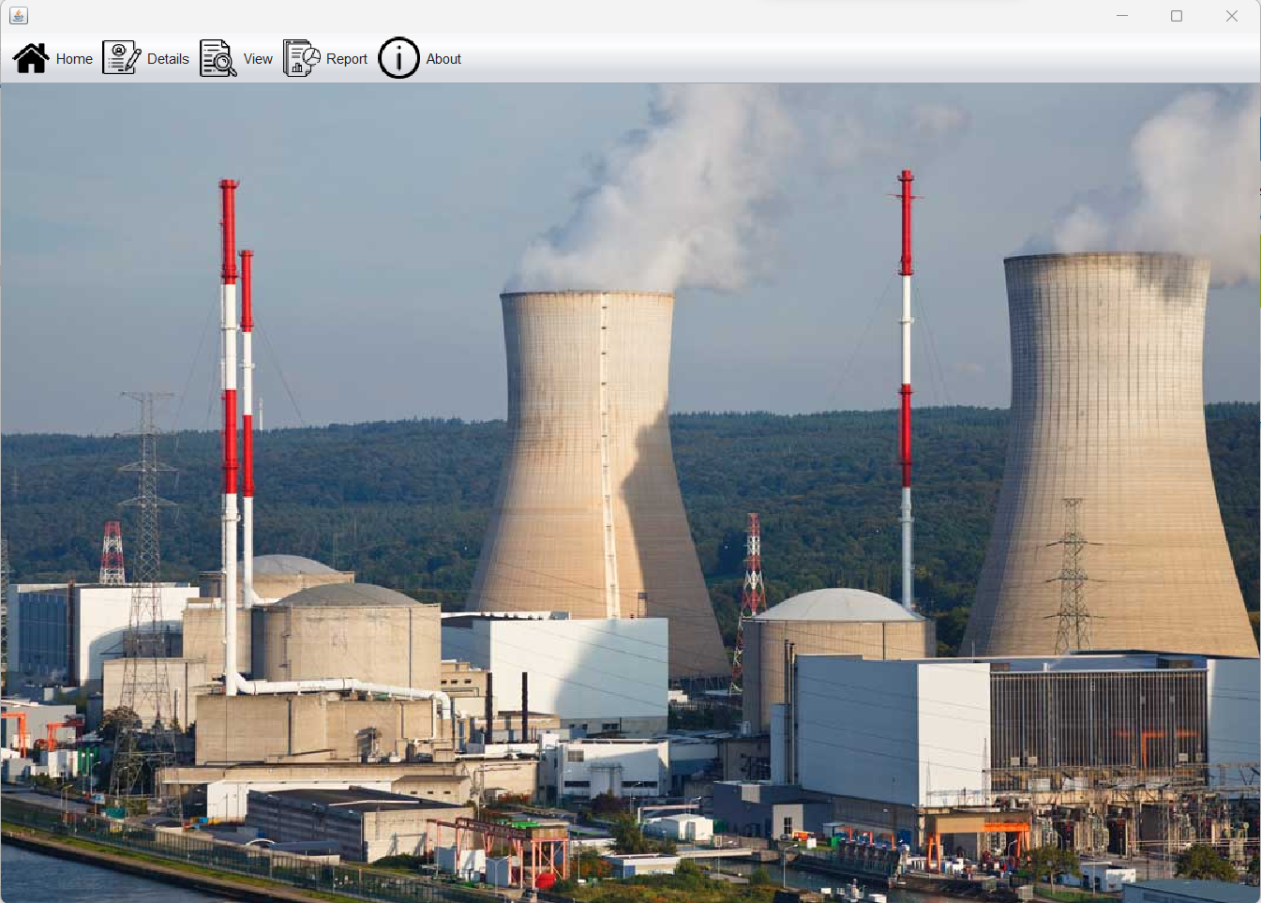
Home Page
Home page will navigate user to every category

Slide 4
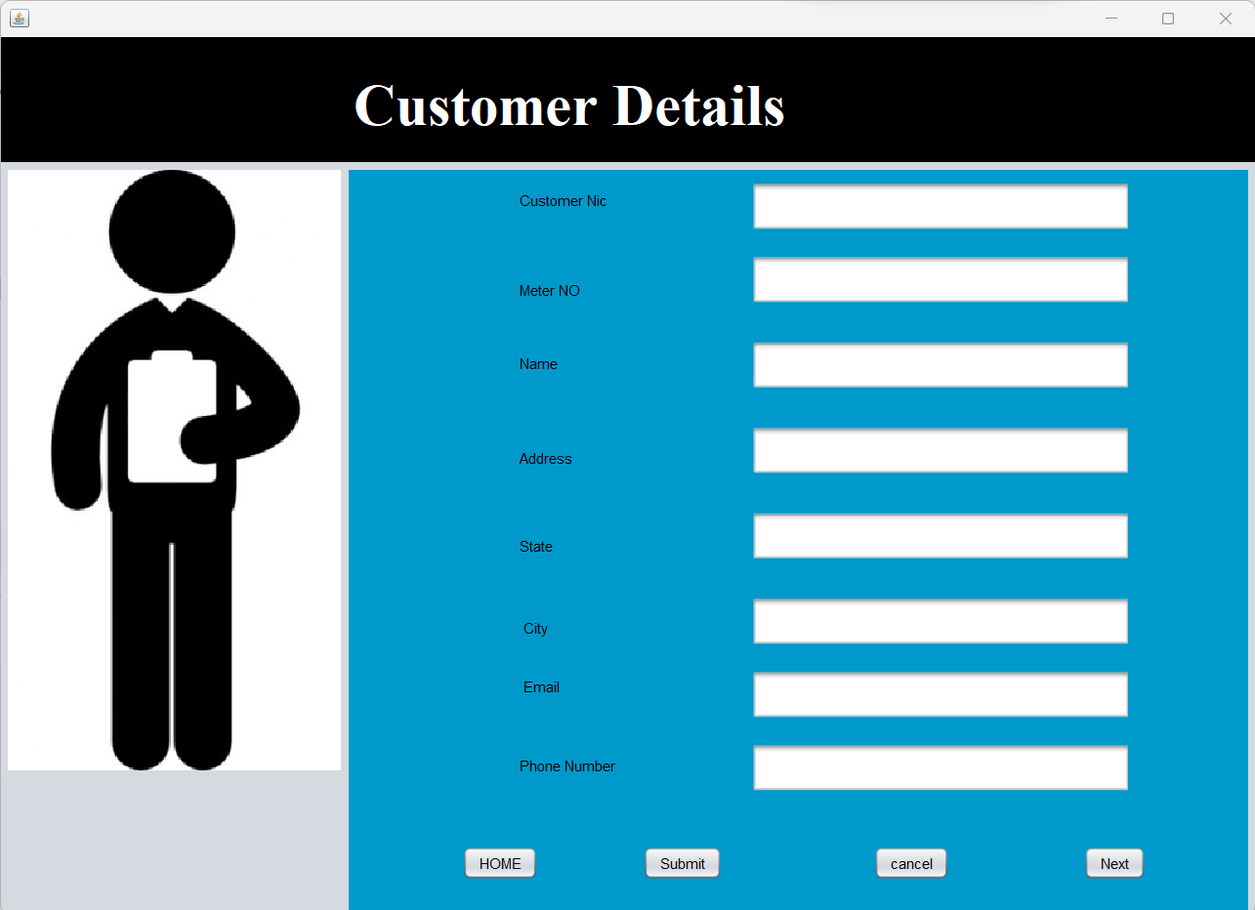
Customer Details
User could insert details about the customers through this forum

Slide 5
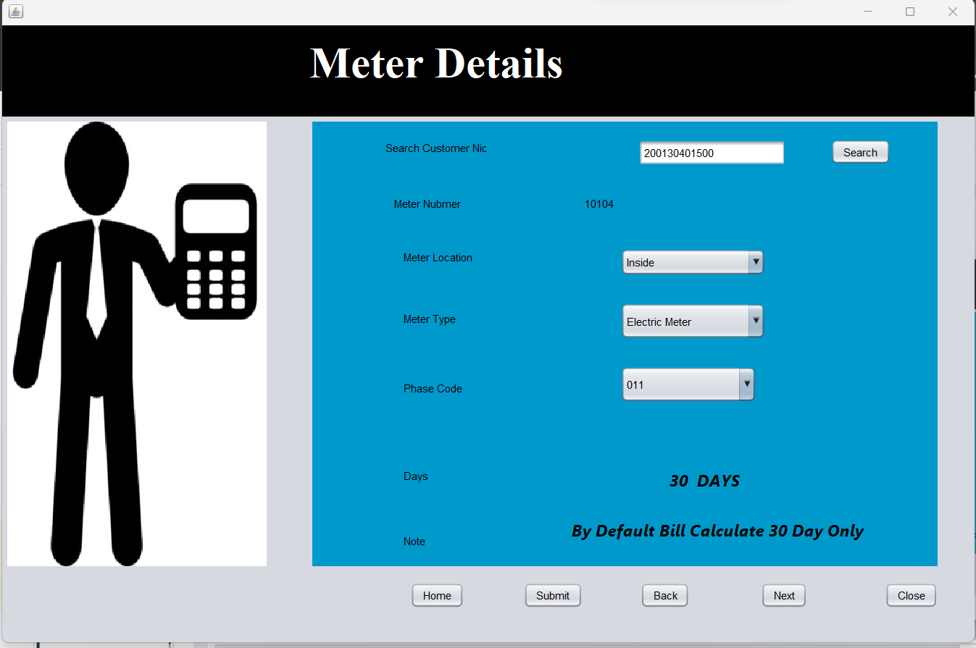
Meter Details
User could insert customer NIC number and search the meter number of that NIC

Slide 6
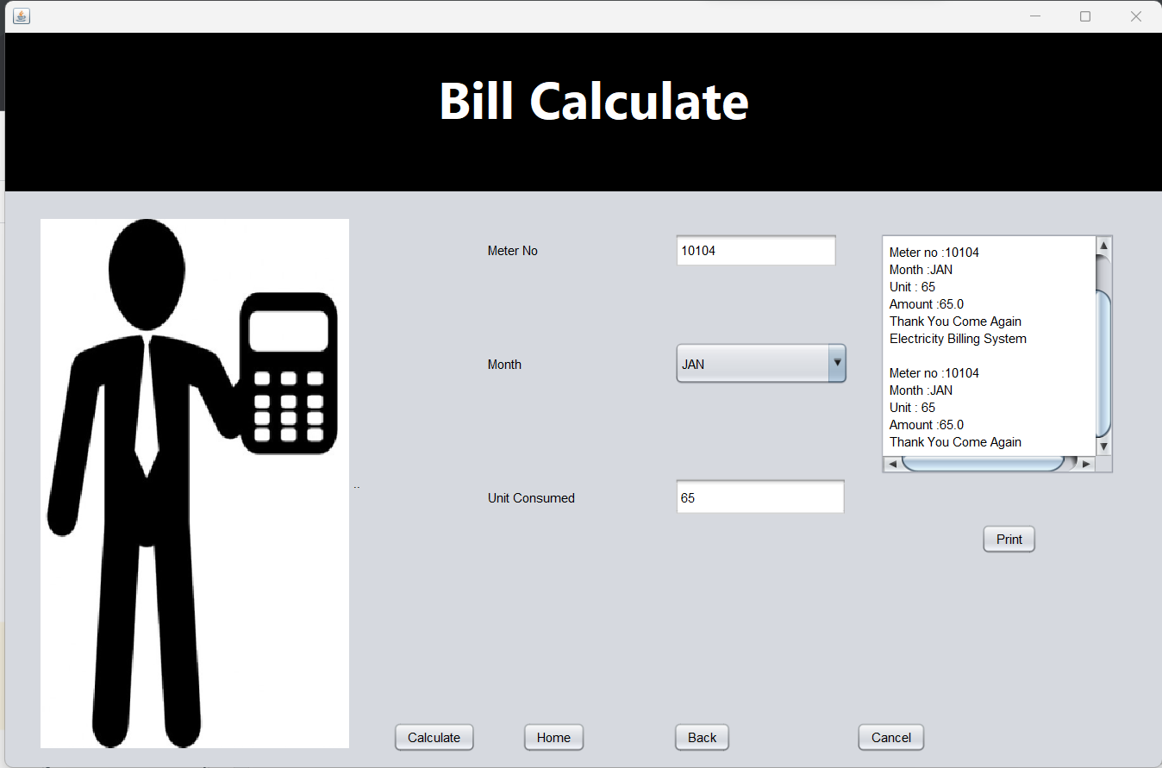
Bill Calculation
User could insert meter number,select the month and unit consumed click the calculate button to calculate the Monthly bill

Slide 7
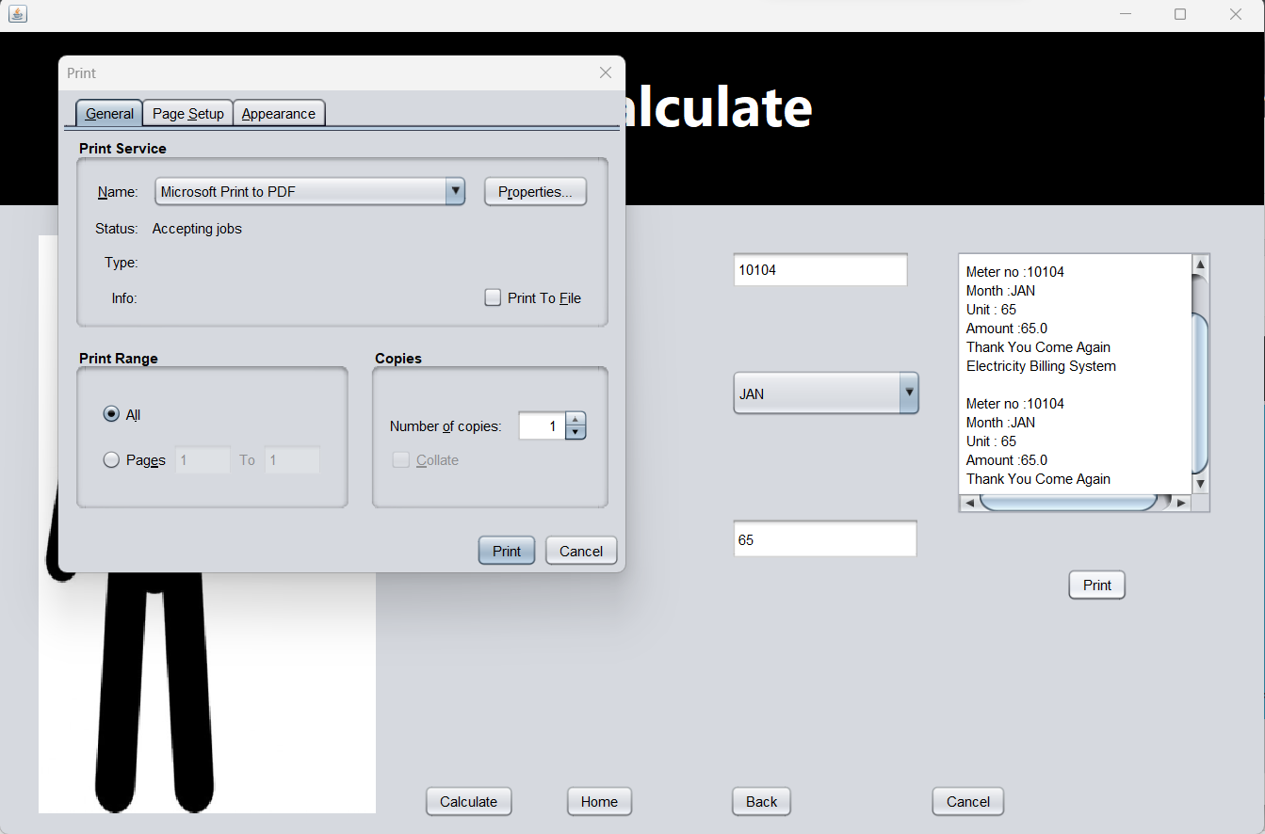
Bill Print
Also user can print the Calculated bill within the app

Slide 8
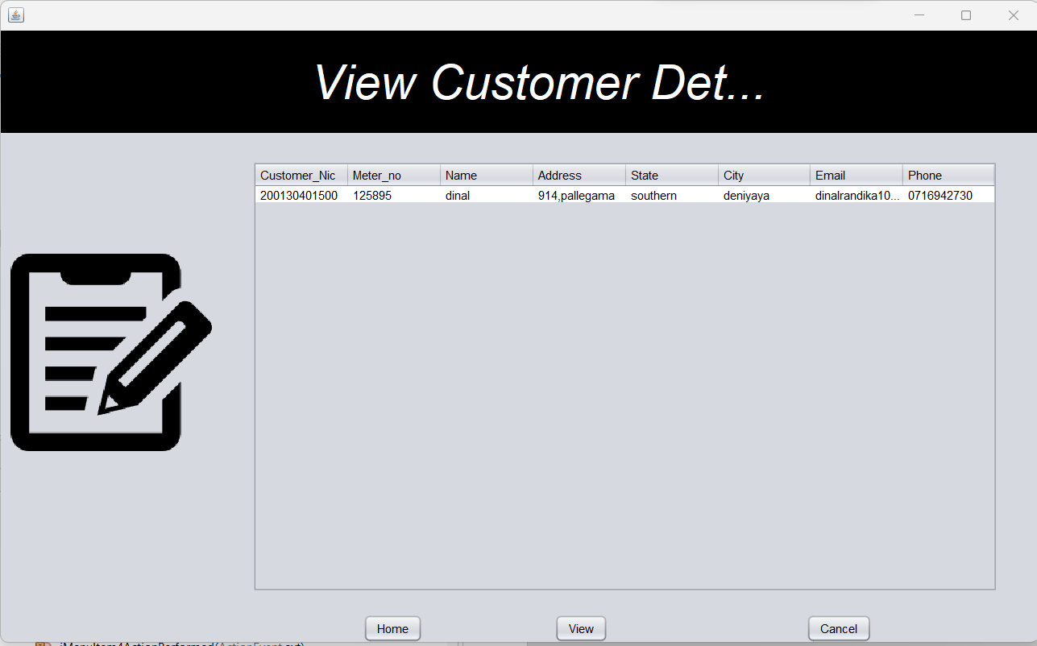
View Customers
By clicking the view button you can view all the details about registered customers

Slide 9
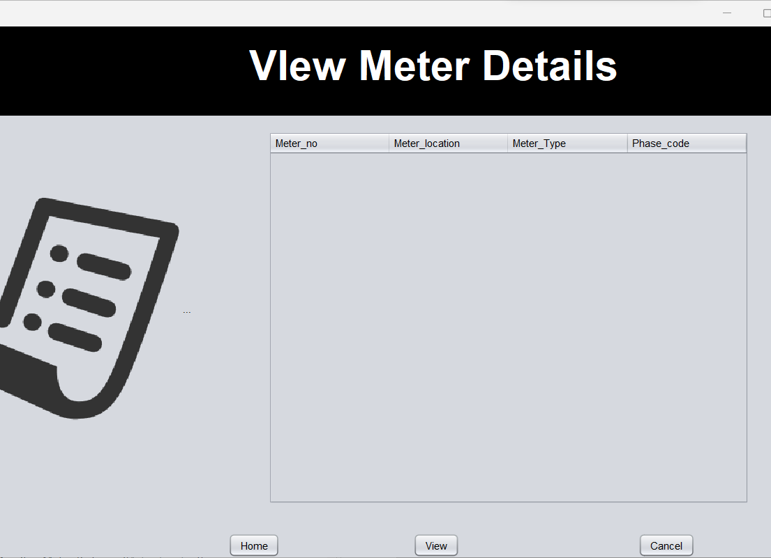
View all meters
By clicking the view button you can view all the details about registered customer’s meters

Slide 10
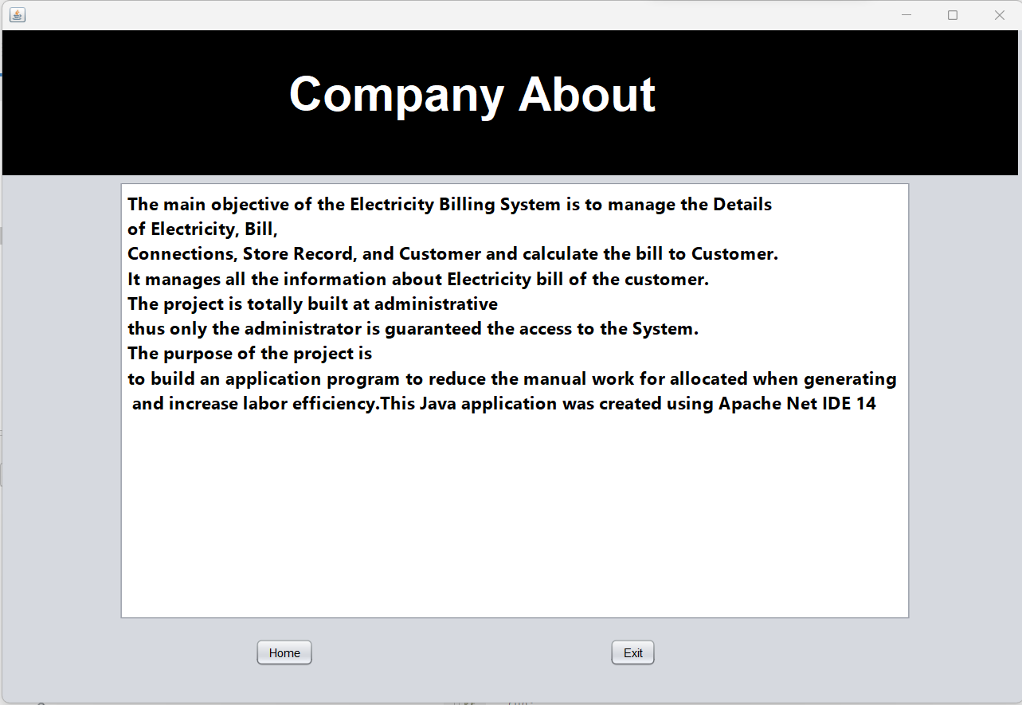
About

Slide 11
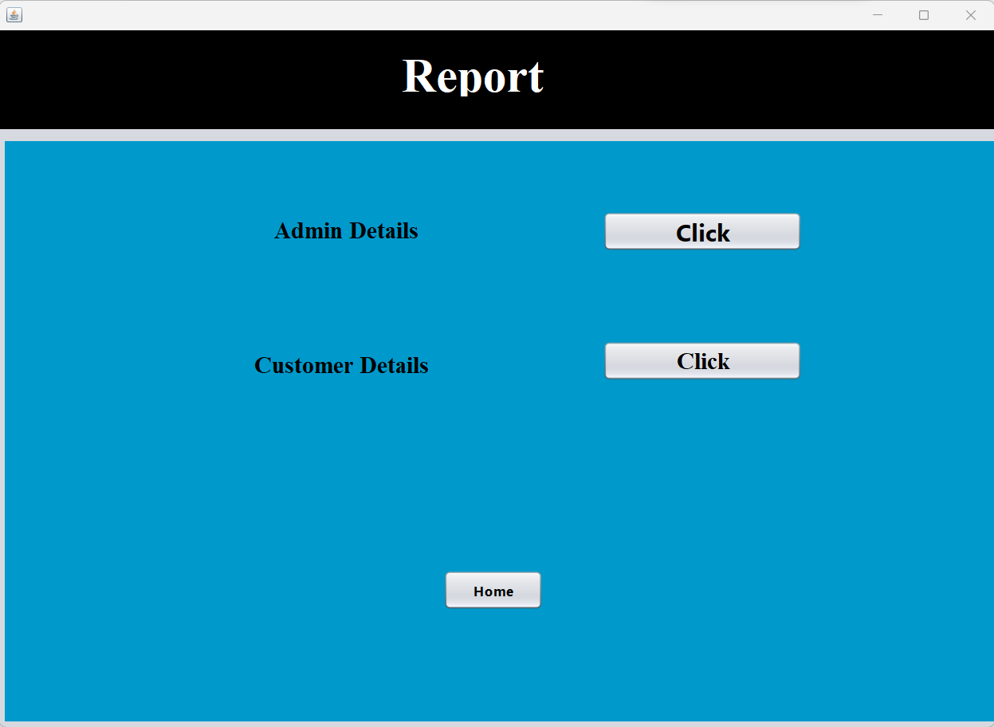
Report

Slide 12
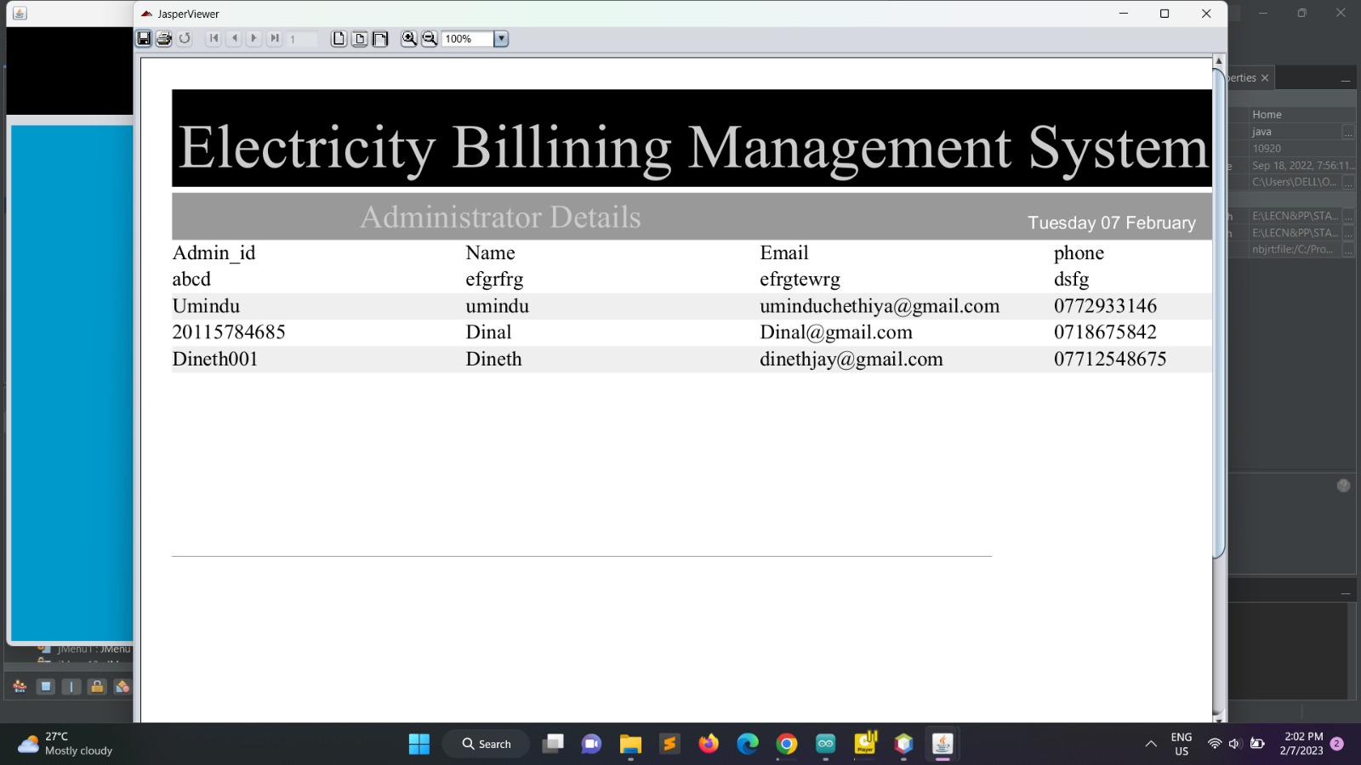
Admin

Slide 13
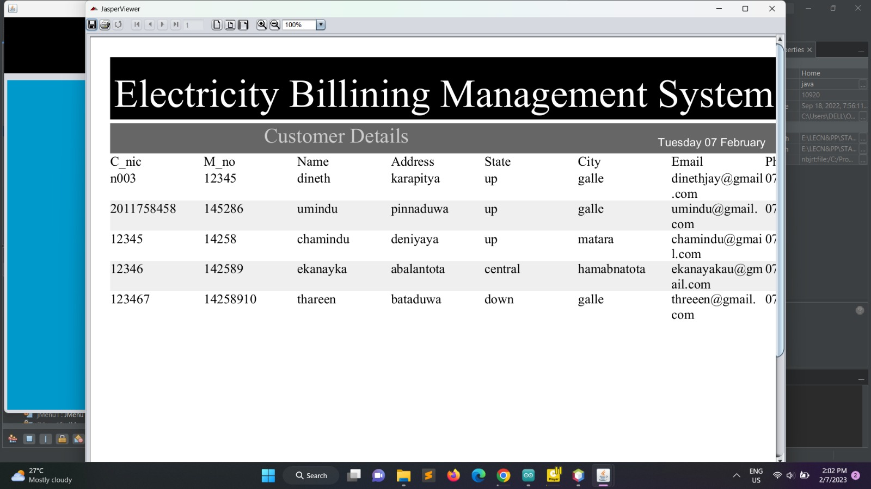
Customer

Slide 14
Link to project code:
https://drive.google.com/drive/folders/1GkjmQMT1T0qKLUo4a2RQm7--9EPDGdxd?usp=share_link

